Slide 1
2024 ANNUAL REPORT
OFFICE OF THE ASSESSOR
County of Kings
Kristine Lee, Assessor/Clerk/Recorder

Slide 2
2024 ASSESSED PROPERTY VALUE IN KINGS COUNTY IS $15.7 BILLION
Notes:
Last year was just under $12 Billion

Slide 4
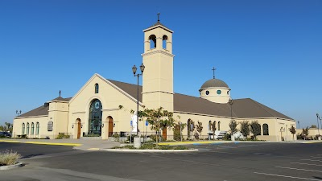
NON-REIMBURSED EXEMPTIONS TOTALLED OVER $754 MILLION (UP 7% OVER LAST YEAR)
Exemptions include:
Disabled Veterans
Soldiers & Sailors
Welfare, Religious, School and Church
Historical Aircraft
Museum and Cemetery
*This does not include Homeowner’s Exemptions since those are reimbursed to the County.

Slide 5
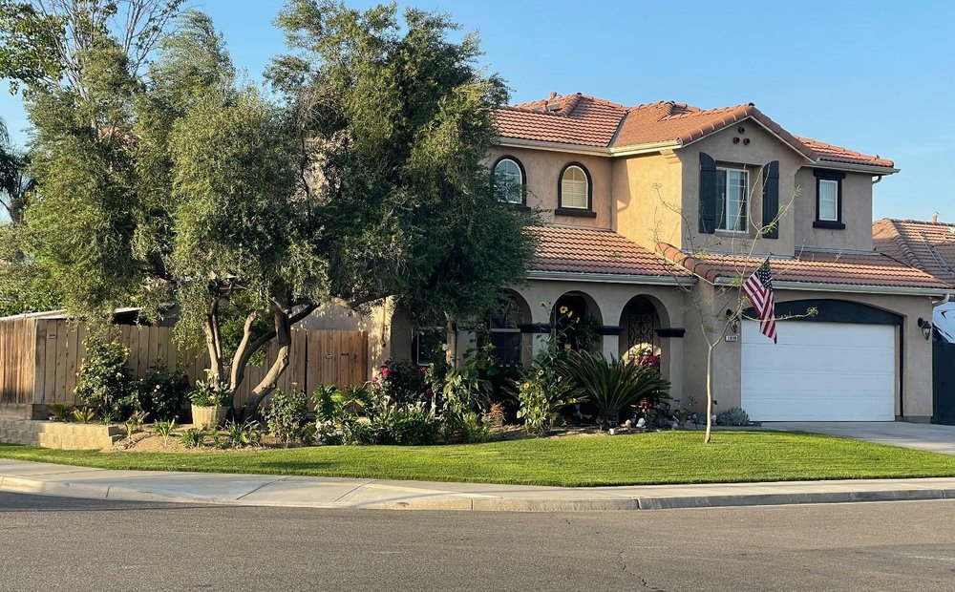
HOMEOWNER’S EXEMPTIONS
For the current year, homeowners will see a total exemption of $95 million (A $600k increase from last year)
The Homeowner’s Exemption is an annual $7,000 reduction of value for a property owner’s primary residence.
These amounts are reimbursed to the county.

Slide 6
OVERALL NET VALUE
The Net Roll in Kings County increased 10.45% to:
$15,695,195,715
(Total Assessments Less All Non-reimbursable Exemptions & Without Utility Roll )
$1.5 billion increase over last year
Notes:
This amounts to $125.3 million in total tax paid by the property owners of Kings County, not counting the State assessed properties.

Slide 7
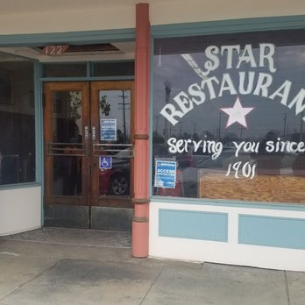
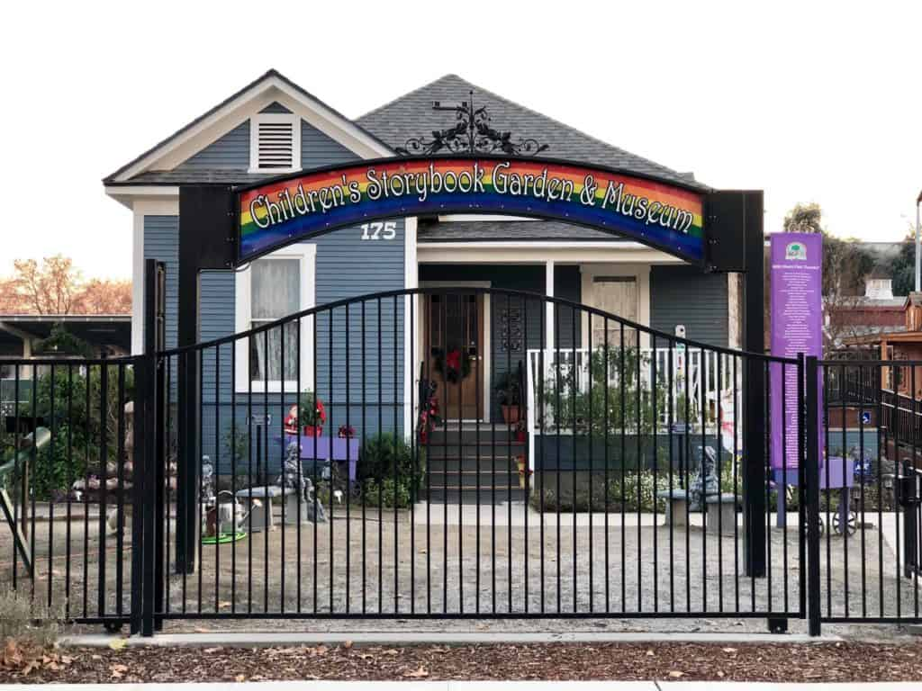
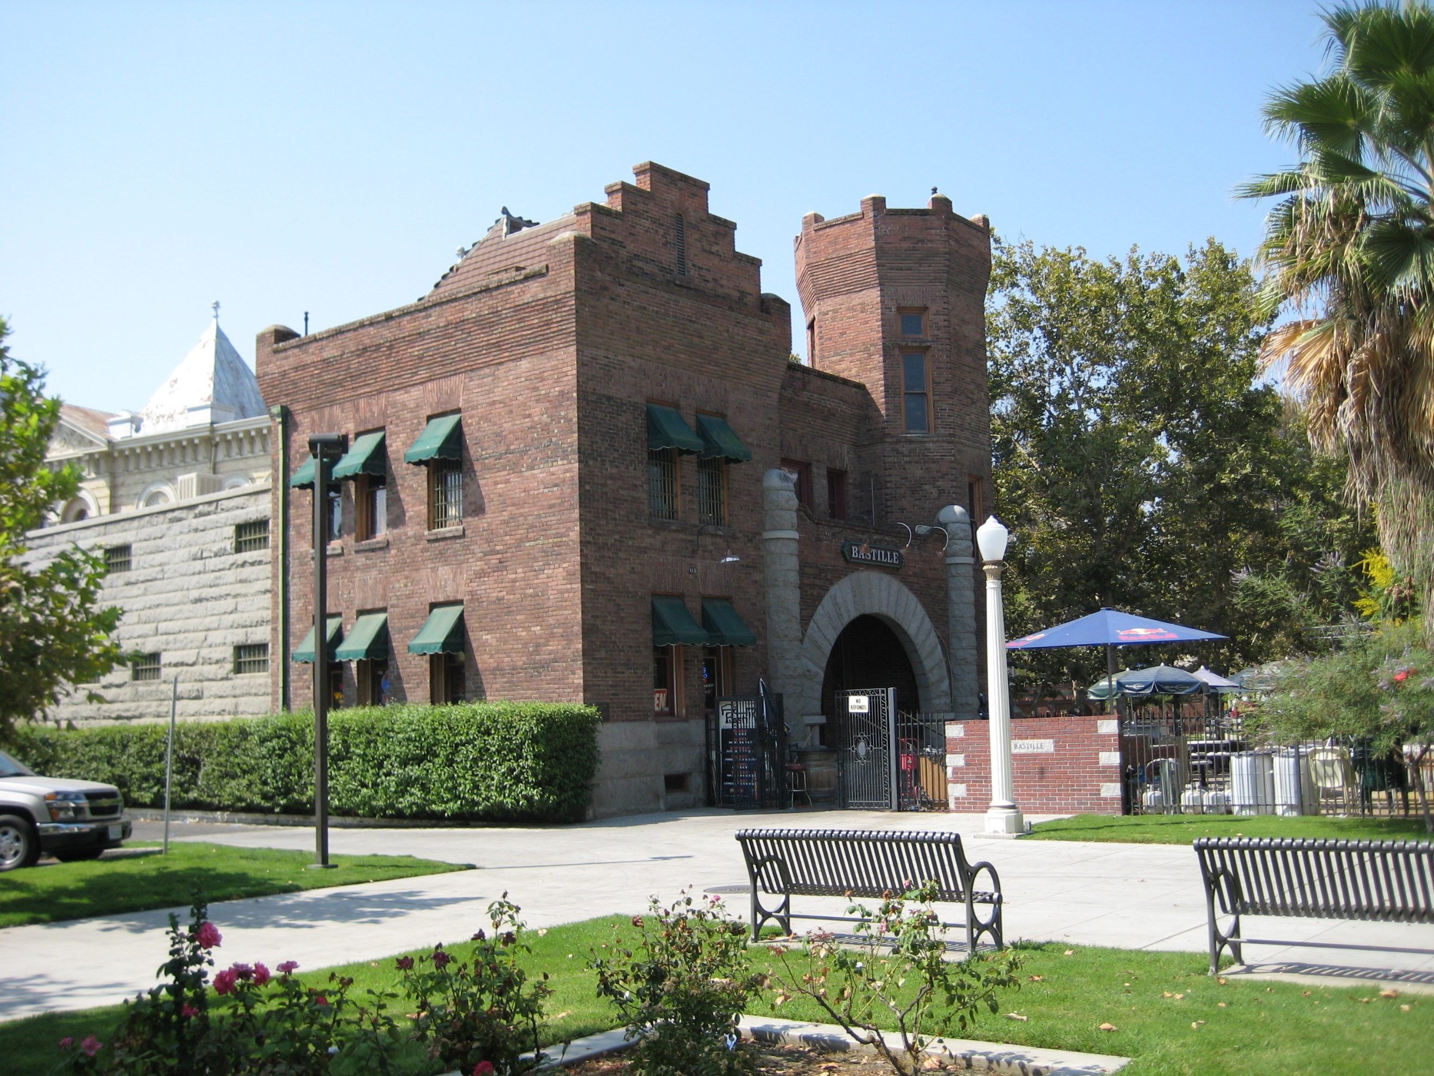
What Has Led to the Increase?
Housing prices increased in 2023 which contributes to new construction and resales of existing properties for the current roll.
2nd owner solar added in the amount of $294 million.
$134 million increase to the roll due to adding back the parcels that are no longer under water from the 2023 Flood.
Jarvis–Gann Factor increased the full 2% (Prop 13) due to the rise of inflation being above 2%.

Slide 8
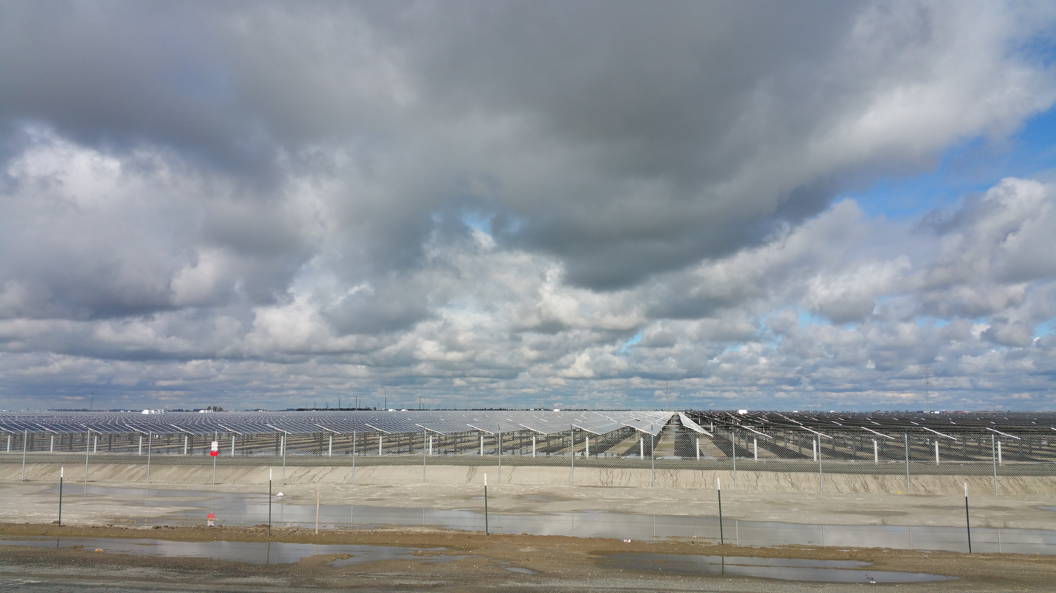
$436 Million in Assessed Value Attributed to Solar in Kings (an increase of $294 million from last year)

Slide 9
SECTION 51 ASSESSMENTS
The Law Requires that Real Property Is Assessed At the Lower Of:
Prop. 13 Factored Base Year Value or
Current Market Value
When the current market value is less than the Prop 13 value, the property goes into a Section 51 Assessment.
Section 51 Properties Require an Annual Review
Properties Assessed Under Section 51 Are Reviewed Annually Until The Current Market Value Becomes Greater than the Prop. 13 Factored Base Year Value, at which Time the Property is Returned to the Prop 13 FBY Value.

Slide 10
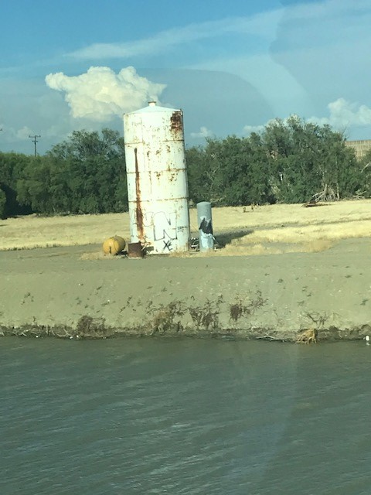
2024 SECTION 51 - MARKET VALUE ASSESSMENTS
Out of 50,812 total parcels in the county, only 272 currently qualify for Section 51
A decrease of 113 parcels compared to last year
That means most properties are at a factored base year or Williamson Act value

Slide 11
OIL and GAS
Oil Assessments remained steady at
$52.6 million in total value for 2024
Notes:
This is a 49% reduction which significantly impacts the City of Avenal.

Slide 12
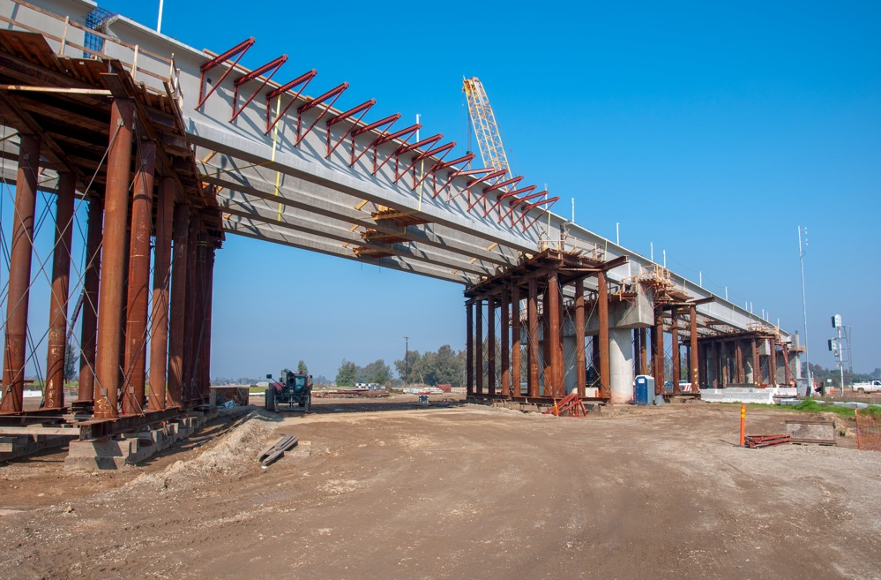
High Speed Rail Properties
1,380 Acres Acquired since 2019
Approximately $24 Million
No Longer Assessable since they are owned by the State
Notes:
Up 39 from 2020 with about $5.1 mil more in value transferred

Slide 13
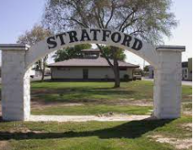
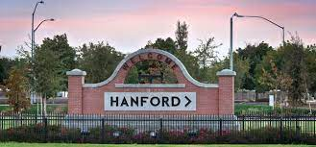
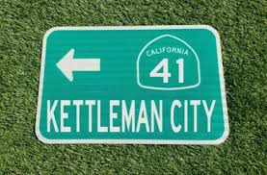
KINGS COUNTY AREAS

Slide 14
2023 SECURED ASSESSMENT ROLL
By City and County Areas
Value Area |  | 2024 | Number of Assessments | % Change
Avenal |  | 312,499,120 | 2,378 | 8.89%
Corcoran |  | 595,179,599 | 3,823 | 7.05%
Hanford |  | 5,565,698,032 | 19,261 | 7.81%
Lemoore |  | 2,511,119,915 | 7,679 | 5.92%
Unincorporated Areas |  | 5,349,485,392 | 17,699 | 9.57%
SECURED ROLL TOTAL |  | $14,333,982,058 | 50,840 | 8.4%
Note: this does not include unsecured properties
Notes:
This table demonstrates the uneven growth of our roll across the county

Slide 15
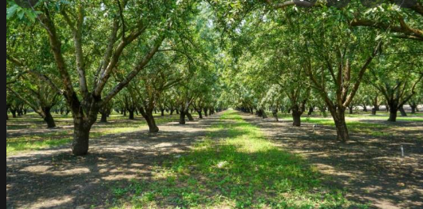
ROLL ANALYSIS
In 2024, the Net Roll is just under $15.7 Billion
20 years ago, the Net Roll was at $5.5 Billion
OVER THE LAST 20 YEARS, THE COUNTY ROLL HAS ALMOST TRIPLED

Slide 16
BREAKDOWN OF THE TAX GENERATED
County General Fund $35,549,618
Cities $ 9,715,326
Special Districts $ 9,558,374
Redevelopment $21,879,103
Schools $80,233,840

Slide 17
APPEALS
The Current Number of Outstanding Assessment Appeals include:
107 Parcels
Most appeals hearings involve several parcels (One Solar Company = 38 parcels)
Most of the above appeals will be resolved before going to hearing
This year’s filing period for Assessment Appeals begins July 1st and runs through September 16th
Notes:
18 are Leprino

Slide 18
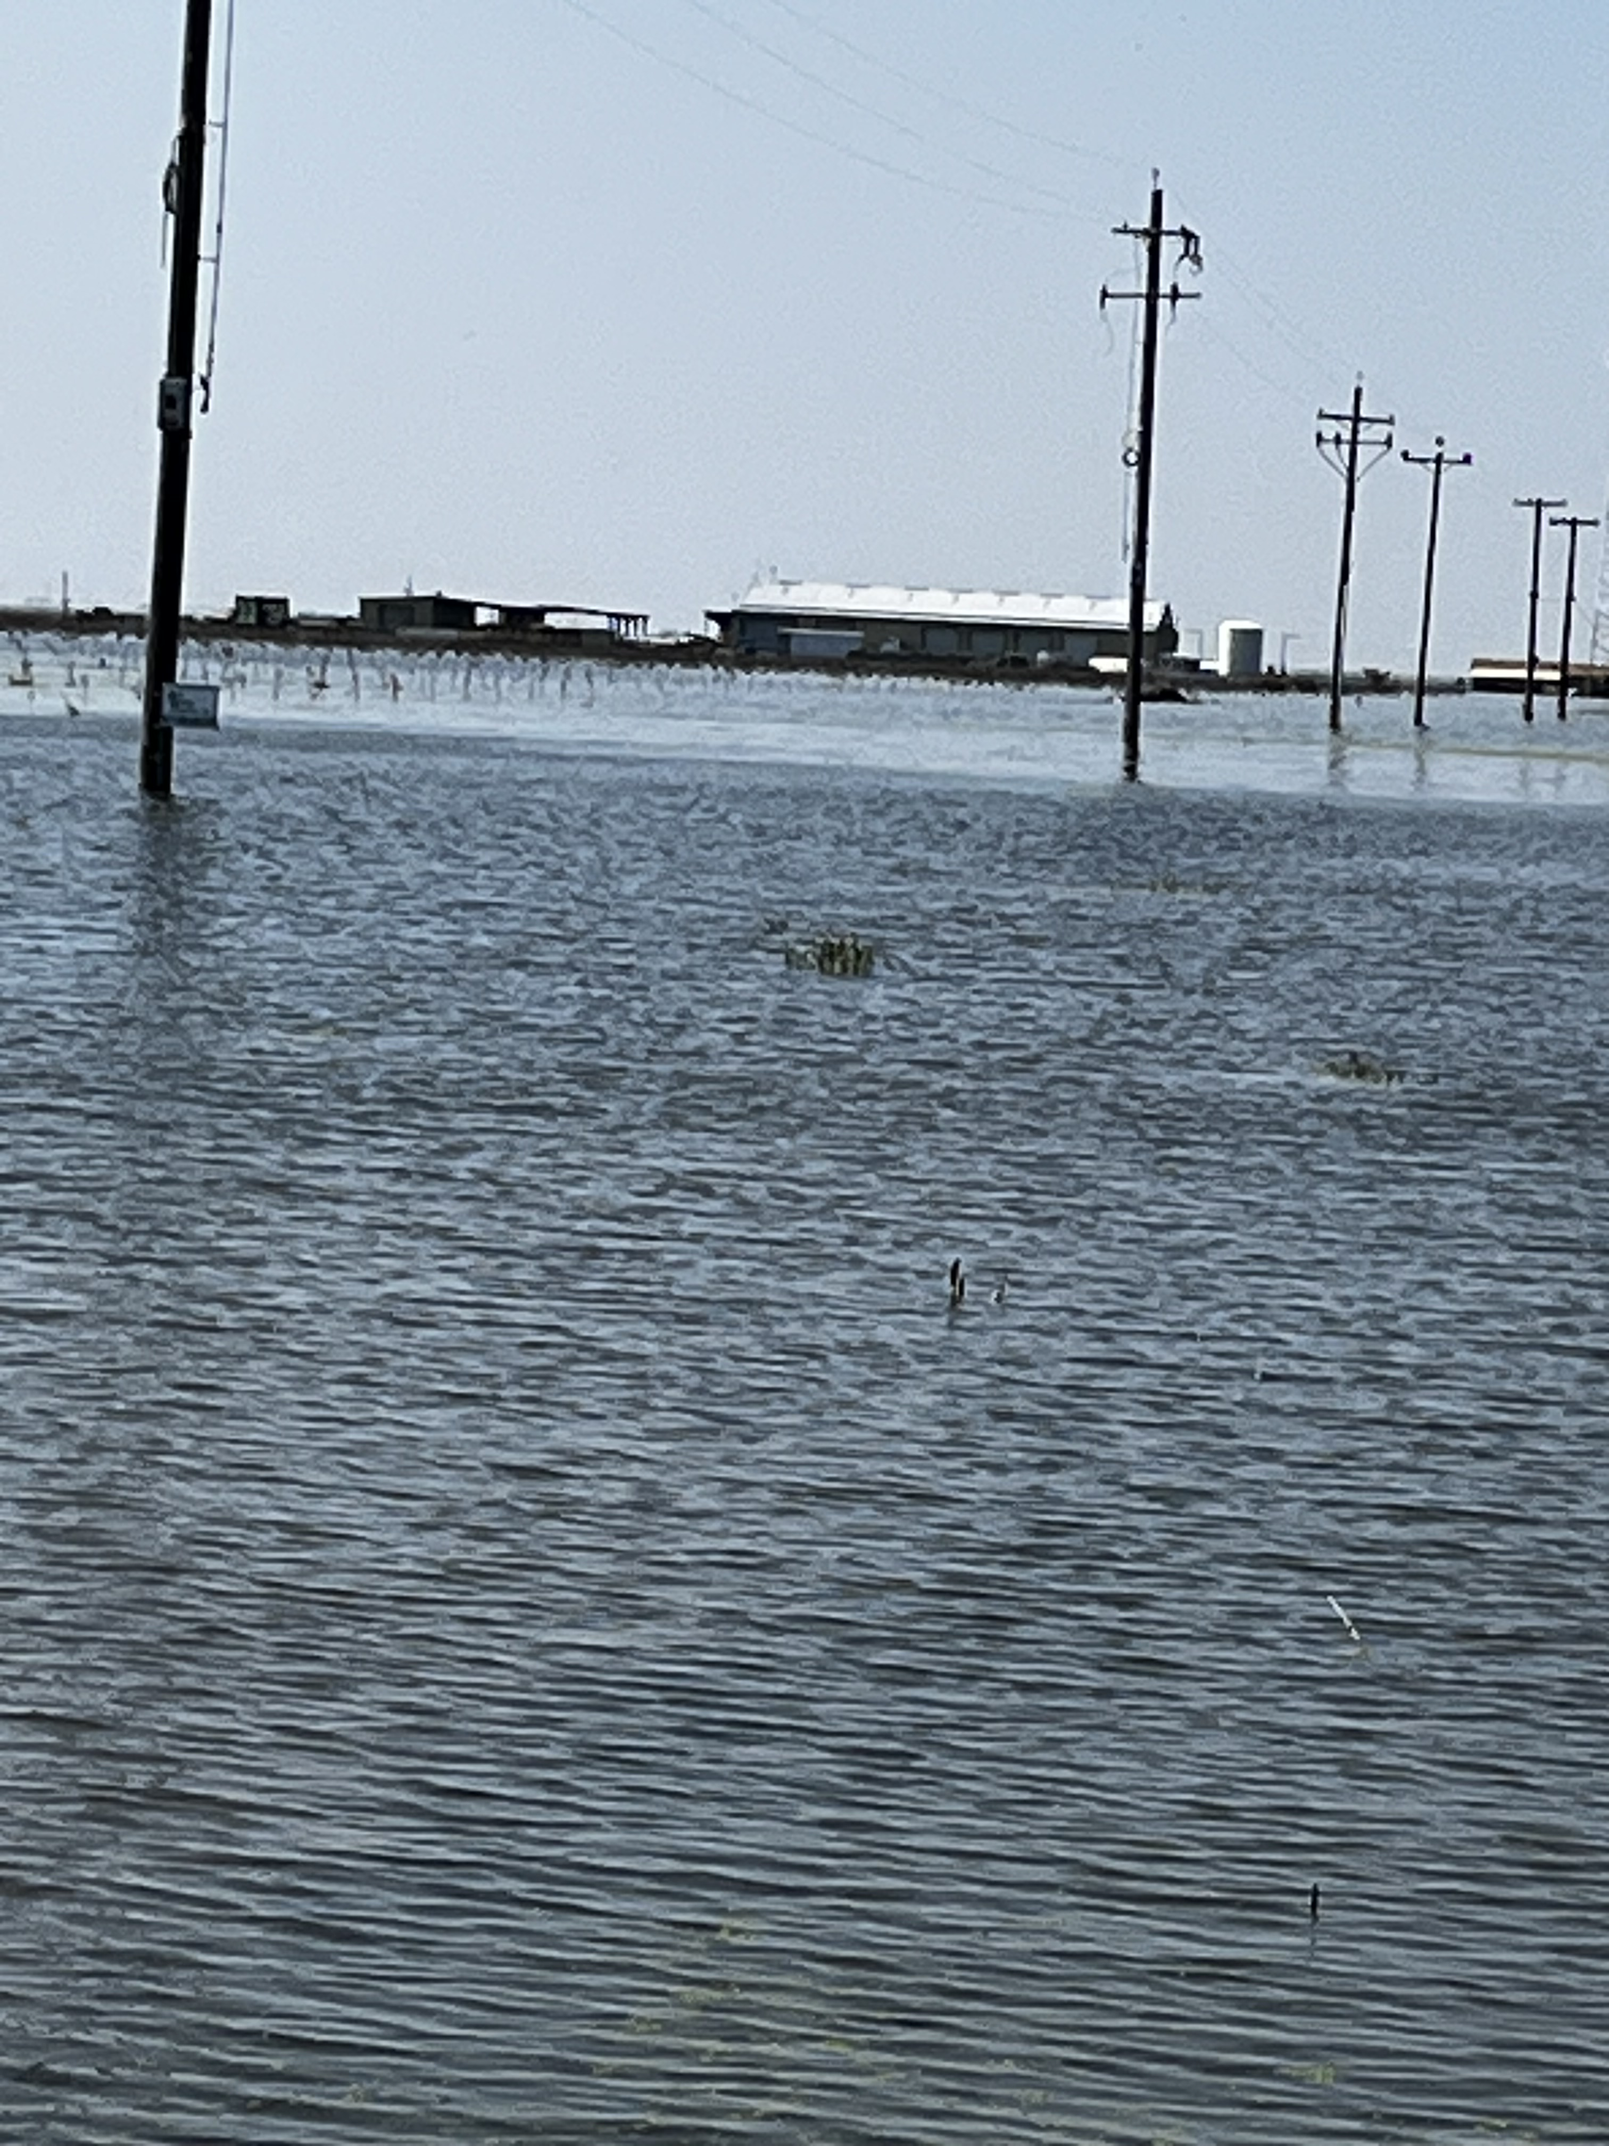
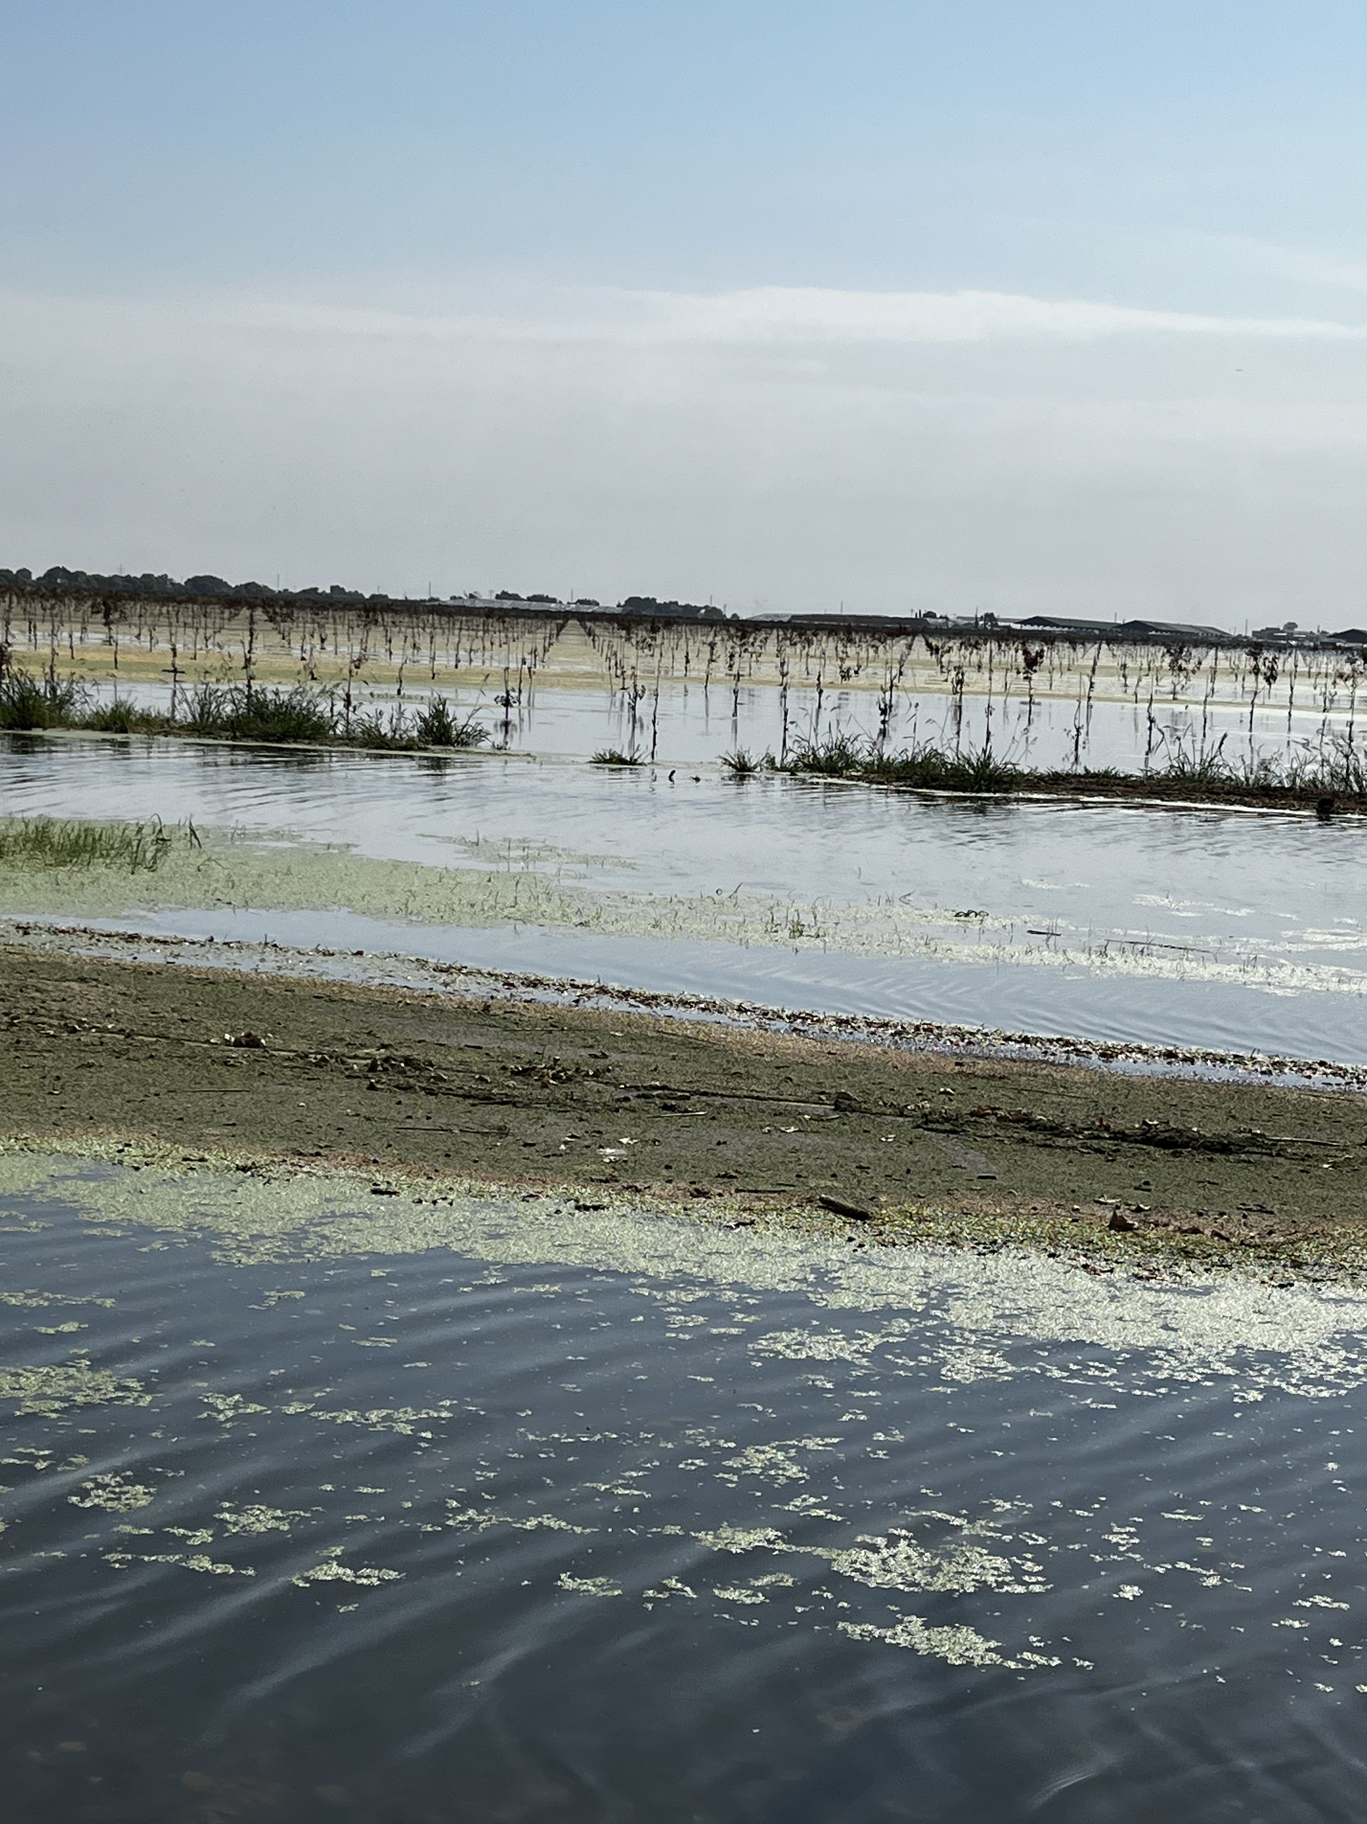
Beginning in March of 2023 the Tulare Lake Basin filled
2023 FLOOD UPDATE

Slide 19
FLOOD (cont.)
Your Board approved a flood ordinance in 2023 that allowed my office to more proactively address flooded parcels.

Slide 20
FLOOD (cont.)
Assessments were reduced for properties under water in 2023.
Although there are still damaged structures that are under review, land values have been added back to the county roll for the 2024/2025 tax year.

Slide 21
OVERVIEW
With the leveling of interest rates, the housing market has been solid over 2023 and into the 2024 year.
Consumer confidence in the U.S. was at 100.4% at the end of June 2024. This is about a 10-point drop from this time last year, likely due to the political climate, but rather steady over the last few months.
The Statewide increase in property values is currently averaging a 5.2% increase.
10.45% increase in Kings County is the largest since 2008 and one of the largest percentage increases of all California counties.
This provides almost $3.4 million more to the General Fund than what was provided last year. My hope is that this will allow for the much-needed salary increases in my office and other county departments. Staff worked extremely hard to make this happen.

Slide 22
STAFF EQUITY
Most staff in the Assessor’s Office is Certified by the State of California
Appraisers, Auditor-Appraisers and Assessments Specialists/Technicians.
Staff must pass a certification exam within their first year of employment or they fail probation.
Once certified, they have 24-hours of continuing education hours that must be obtained each year.
The duties are often complicated and often require complex analysis.
Although the current wages do not adequately compensate for the skills necessary to accurately produce one of the largest contributions to the General Fund, staff has been patiently hopeful that the compensation study would result in fair compensation.
Unfortunately, Koff & Associates did not account for the certification requirement of the Assessment Specialists/Technicians and compared them to non-certified counties.
Your Board, sitting as the Board of Supervisors, has stated that county employees should be compensated for advanced trainings, so I am hoping that while you are sitting as the Board of Equalization, a position that is designed to create equity, you will take these comments into consideration when approving compensation adjustments.

Slide 23
THANKS TO THE INCREDIBLE TEAM
The Assessor’s Office team has worked diligently to provide great customer service while also ensuring the property roll is complete and accurate.
Assistant Assessor/Clerk/Recorder: Tim
Chief Appraiser: Erica
Appraisers: Susan V., Alex C., Alex Z, Angel, Cristian, Joshua, Michelle, Angela, and Jose
Auditor-Accountant: Mayra
Auditor-Appraiser: Gabriela
Assessment Specialists and Assistance: Crystal, Monica, Levi, Sherry, Felicia, Rosalie, Brittany, Lizeth, and Samara
Cadastral/Mapping Service: Casey
Executive Secretary: Elizabeth
A lot of the work could not be done without the Clerk-Recorder team recording the property transfers and assisting whenever needed:
Susan M., Justine, Martha, Alejandra, Tracy, Rachel and Myla

Slide 24
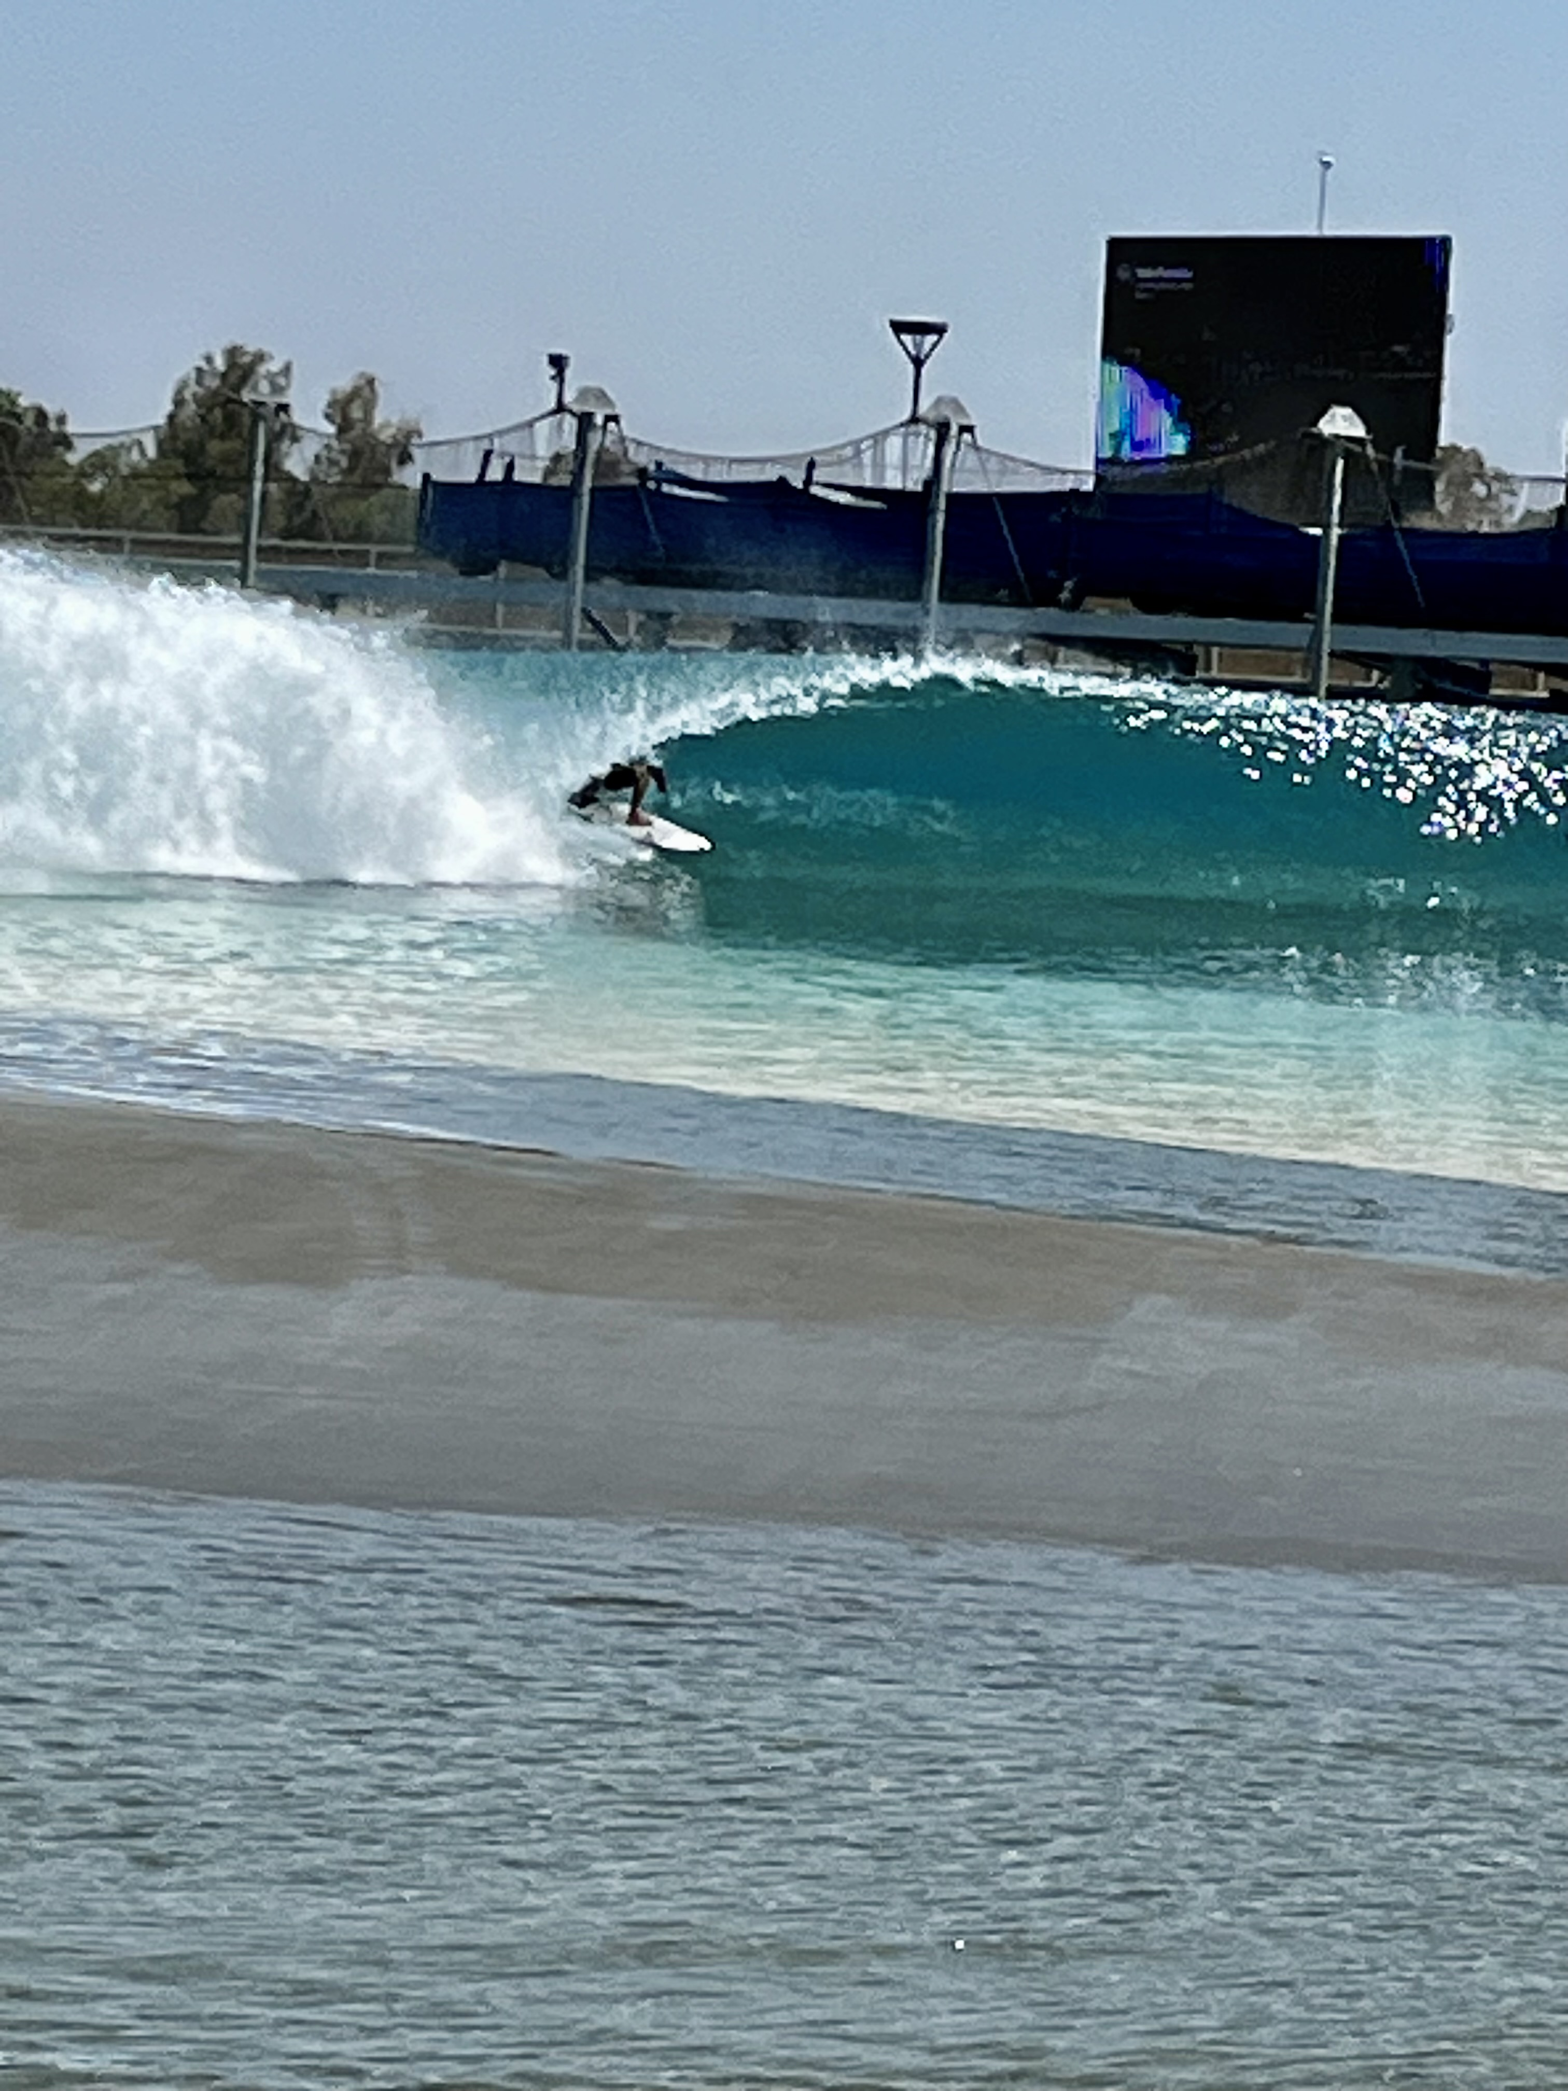
2024 ANNUAL ASSESSMENT ROLL REPORT
This Concludes the Presentation and Report of the 2024 Assessment Roll and Information
ANY QUESTIONS?

