Slide 1

WOMEN’S HISTORY MONTH 2023
In Kings County
Notes:
March is the month when we take the time to look back and honor the many achievements of women through history and the vast strides made by women today.
The annual observance of National Women’s History week was declared in a presidential Proclamation by President Carter in 1980 and was declared National Women’s History Month by Congress in 1987.
Women’s history takes a new look at all that has gone before and tells the story of a shared past from a different perspective, not rewriting history, but presenting and expanding a version of history that recognizes and honors the accomplishments of women.
Women’s history takes a new look at all that has gone before and tells the story of a shared past from a different perspective, not rewriting history, but presenting and expanding a version of history that recognizes and honors the accomplishments of women. This year each of our Board members selected a recipient of the recognition additionally staff requested each County Department Head to nominate someone from their department to receive the recognition. This year we recognize women who are currently affecting the future through their commitment to public service and government leadership

Slide 2
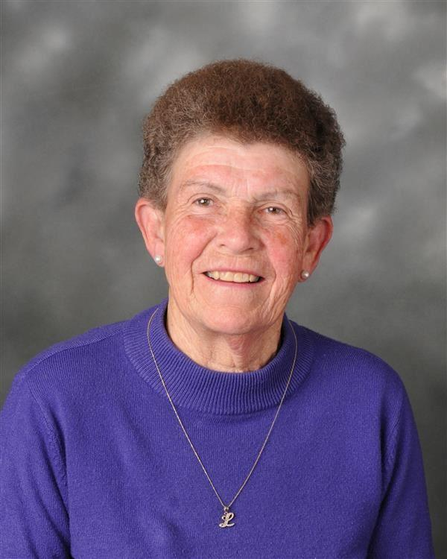
Women’s History
Month 2023
Lois Hubanks
District One
Notes:
District 1 – Joe Neves
Mrs. Lois Hubanks grew up in Denver, Colorado. She majored in Physical Education at Greeley College in Colorado; now know as Northern Colorado University. Mrs. Hubanks was recruited to the beautiful sunny San Joaquin Valley as a Physical Education teacher at Lemoore High School where she taught for 34 years.
Throughout her 34 years, she started the Girls Gymnastics program, coached Diving, and was head of her department.
She was elected to the Lemoore High School Board in 2002 and inducted into the Lemoore High School Hall of Fame in 2006. She is very active with all activities at Lemoore High School and it is said that she “bleeds purple and gold”.
Mrs. Lois Hubanks lives in Lemoore and both of her children graduated from Lemoore High School. In her spare time, she enjoys her two granddaughters and grandson. She enjoys substitute teaching at the primary level and gardening.

Slide 3
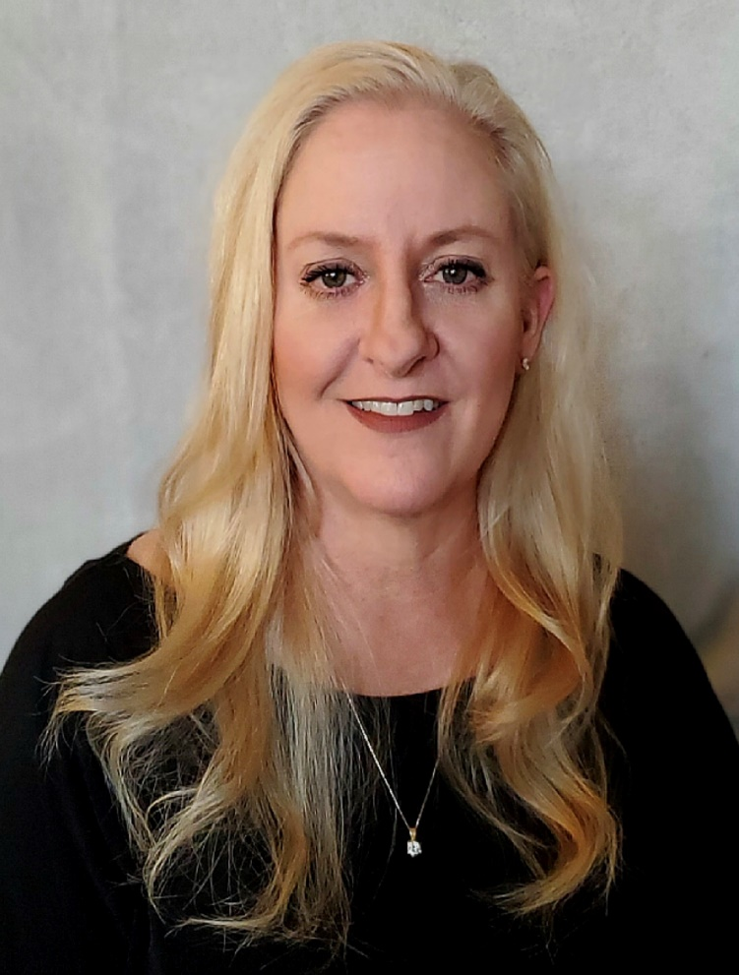
Women’s History
Month 2023
Lisa Shaw
District Two
Notes:
District 2 – Richard Valle
Lisa Shaw
Lisa was born to Dennis and Carole Burner August 24, 1971 in Visalia, Ca. She attended Waukena Elementary School where she was active in sports, participated in spelling bees, math contests, and speech contests. Lisa was in the student council, serving as Secretary and Treasurer of her class. She graduated as Salutatorian and went on to attend Tulare Western High School where she played softball and was heavily involved in art classes. Lisa was a 9 year member of Waukena 4-H, winning several awards for her cooking and art projects. Her artwork was selected to hang at the California State Capital. She held the offices of President, Vice President, Secretary, Treasurer and Sergeant of Arms in Waukena 4-H. She graduated from Tulare Western as one of the top ten students.
Lisa has been at the Corcoran Chamber of Commerce since 2006 and has a background in marketing, advertising and event planning. She attended Cal Poly, San Luis Obispo and started her career in Marketing and Advertising at JPAX Communications. Clients included Fig Garden Village Shopping Center, the Fresno-Madera Medical Society, the Fresno Chamber of Commerce and the Kings, Tulare, Fresno and Madera County Farm Bureaus.
Lisa sits on several boards and committees including Corcoran Rotary, Corcoran Museum Committee, Corcoran High School CTE Program, Corcoran Thursday Club and Corcoran Organization's Committee.
She is a long-time resident of Waukena and lives with her husband Jason, where they were active in Waukena 4-H as leaders of Market Lambs, Foods & Nutrition, Photography, Archery, Arts & Crafts, Record Book Keeping, Gardening and Shotgun Training. Both sit on the Valley Ag Boosters Board, an organization supporting today’s youth to become tomorrow’s leaders in agriculture. Their daughter Delaney attends Kansas State University as a junior, was a member of Alpha Gamma Delta Sorority and is a member of the Kansas State Meats Evaluation Team, Meat Science Quiz Bowl Team and Livestock Meat Animal Evaluation Team.
Lisa was a member of the Corcoran 50/50 Club, holding the position of Secretary, Vice President and President. Lisa is a member of Visalia Christian Reformed Church and sat on the Congregation of Life Team. As a member of Corcoran Rotary she serves as the Secretary/Bulletin Editor, Webmaster and President-Elect for 2024-2025.
Lisa works closely with several other organizations in Corcoran. Special projects include the Grand Opening of Gateway Park, American Flag Replacement Project, Downtown Corcoran Recovery Project, Healthy Skin Sunscreen Project, Corcoran Centennial Celebration, Corcoran Cash, Community and Schools Together Student Recognition Project, Corcoran Hometown Hero Project, COVID Projects, Downtown Music Project, 100th Christmas Tree Celebration, Christmas at the Park, Memorial Wall Project, Corcoran Museum Committee Walking Tour and Corcoran Trunk or Treat.
Lisa loves the close-knit community of Corcoran and the surrounding communities.

Slide 4
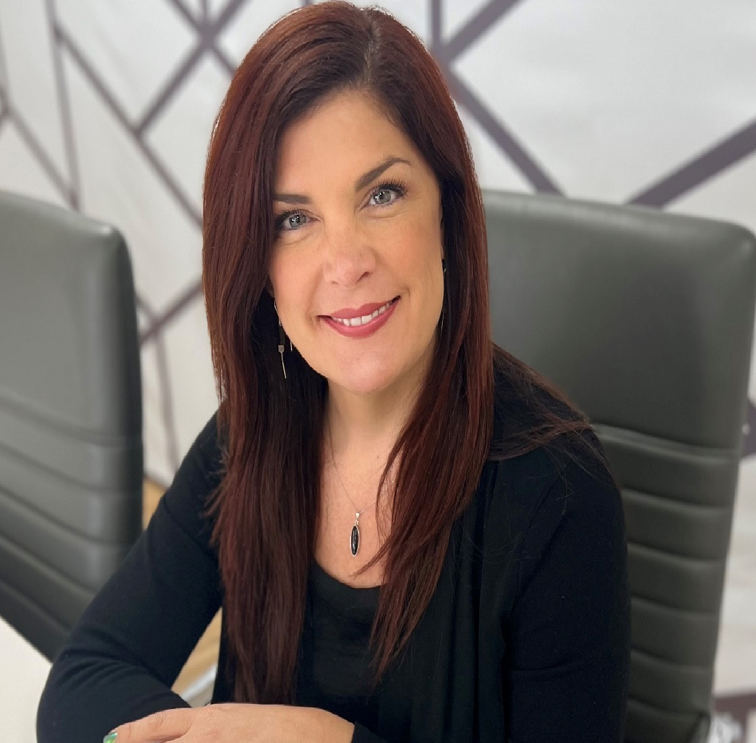
Women’s History
Month 2023
Michelle Brown
District Three
Notes:
District 3 – Doug Verboon
Michelle Brown
Michelle Brown was born and raised in Hanford and after spending time in San Diego and Nashville, she returned to Hanford to raise her two children. Michelle has worked for Main Street Hanford since 2016 and became the Executive Director in 2018. Michelle, along with her staff and volunteers are responsible for approximately 30 community events throughout the year. Events include Thursday Night Market Place, Hanford Blues & Roots Festival, Witches Night Out and Wine & Chocolate Tasting. It is Michelle’s mission to continue to revitalize, support and promote downtown Hanford and its unique businesses. Michelle’s efforts to support businesses throughout the pandemic earned her the award for Citizen of the Year, presented by Hanford Chamber of Commerce. Ultimately, Michelle hopes that their revitalization efforts with Main Street Hanford, would transform downtown Hanford into a destination and one of California’s hidden gems.

Slide 5
Women’s History
Month 2023
Pauline Hershey
District Four
Notes:
District Four- Rusty Robinson
M. Pauline Hershey – Professional Bio and Longer Life Story – lol.
First, I am very honored to be selected by Supervisor Robinson. We all are standing on the shoulders of the giants who went before us, and I am no exception. I am so grateful for the mentors and friends who help steer my path.
I am a “seasoned” communications professional, experienced in all facets of marketing and communications, as well as leadership, team building and change management. Interested exclusively in projects for social good. Experienced with cross sector partnerships and collaboration. I am a serial entrepreneur who optimistically believes business has the potential to change the world. My purpose is to facilitate positive change, through strategic communications. My day job is as Founder at All Valley Printing, or avprint.com, in Hanford.
Favorite Quote: “The future belongs to those who believe in the beauty of their dreams” - Eleanor Roosevelt
Favorite part of job: Being able to make a positive difference for our clients and community. Working with amazing team members throughout these 30 years.
Favorite Charity: My Favorite Charity is Rotary. Rotary can make a difference where governments, political parties and religious organizations cannot, because it is open to all and crosses these lines.
For more information: https://www.rotary.org/en/our-causes
Strength: Helper
Weakness: Never Satisfied
Meet Pauline Hershey-Gambino l Communications Chair
7 Sayings I Love…
“Do what you love, and you never work another day in your life” - Confucious
“Don’t sweat the small stuff… and it’s all small stuff.” Richard Carlson Ph. D.
“The Future Belongs to those who believe in the Beauty of their Dreams” – Eleanor Roosevelt
“There are no strangers, just friends I haven’t met.” - William Butler Yeats
“People, I just want to say, you know, can we all get along?” – Rodney King
“I’ve forgotten more than you’ll ever know” – Bob Dylan
“God Enters by a Private Door, into Every Mind” – Ralph Waldo Emerson
That about sums me up, but here is the most abbreviated bio I can give…
In 2004 I married the love of my life, Paul Gambino. Our blended family includes 7 kids ranging from 41 years down to our Sophomore in High School. Suffice it to say, raising 3 generations of kids keeps things fresh. I was born and raised in Visalia, California. I have two siblings, Chris and Diana. Dad taught vocal music and my mom, elementary school. Being the daughter of educators, I became a lifelong learner. So grateful for this, because the year I graduated from high school was the same year the personal computer was invented. Talk about changes to how we work and communicate.
Early on, I earned my Bachelor of Fine Arts, Graphic Design from UCLA. After college I worked for a design firm, home video company, television network and a record label - all in Southern California, prior to starting my own business. I loved the energy of the big city back then. Moving to Kings County wasn’t easy, but man – no traffic jams, friendly people and being able to drive across town (Hanford) in 5 minutes, sure were pluses! I’ve called Hanford my home since 1993.
Business ownership began in 1991 with the purchase of a distressed print shop in Canoga Park. All Valley Printing, Inc. (or avprint.com) was originally called “Iguana Press”. In August of 1993, I relocated to Hanford, California. Getting involved in a small community is a lot easier than in LA. The Chamber of Commerce was SO welcoming. I joined the Rotary Club of Hanford in 1999. PDG J. Richard Neill (Dec.) told me in no uncertain terms that to do business in Hanford, I must join Rotary. So I did. But of course, Rotary, I learned quickly, was so much more than networking and connections. I have also been involved in our local Chamber of Commerce, Main Street Hanford, Kings Art Center and city planning processes.
In the aftermath of the recession of 2008, I chose to dive more into “Communications for Good”, working with Cause Communications; facilitating the re-development of Kings Partnership for Prevention; and as Resource Development Director with the Boys and Girls Clubs of Fresno County. Finally, I decided to take some courses in Comms Mgmt. What a blast. I did have to take a mental health break, learning that one cannot successfully operate without sleep for days on end. (Not pretty). like Dorothy in the Wizard of Oz, I came home to my small company AND to my original Rotary Club. I’ve been happily playing at my day job again for the past 6 years. There truly is “no place like home”.
Most recently, I was asked by District Governor Bruce Mackey to be Communications Director for Rotary District 5230. Kings, Tulare, Fresno and Monterey Counties. Previously I had 2 stints under PDG (Past District Governor) George Wade and PDG Shirley Grace, where I helped them to visually communicate their individual themes. George’s “Joined-Stayed” campaign and Shirley’s “We are Rotary”. I am very proud of this work. Spare time? Concerts, Museums, Yoga and Travel. Beginning in July, I move from District wide volunteering back to my home club, Rotary Club of Hanford, as President-Elect.
I LOVE Rotary. I believe when we aspire to live by Rotarian principles, there is nothing we cannot accomplish together.
Peace Out.

Slide 6
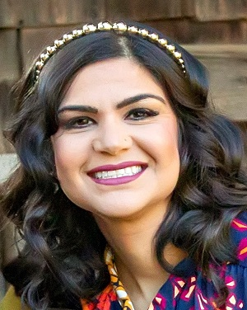
Women’s History
Month 2023
Parveen Sandhu
District Five
Notes:
District Five- Richard Fagundes
Parveen Sandhu
Executive Director for Kings Waste and Recycling Authority
Parveen was born in Yuba City Ca and raised in Lodi Ca. She attended California State University Sacramento with a Bachelors of Science degree in Criminal Justice in 2005. Mrs Sandhu was the first to graduate from college in her family. She is currently in pursuit of her Master’s degree in Leadership and Management and will graduate later this year. During her professional career, Mrs Sandhu had worked with the USDA, private circuit board companies, Tulare County and now is the Executive Director of Kings Waste and Recycling Authority. Mrs Sandhu currently resides in Selma Ca where she is very active in her community. She is on the City of Selma Planning Commission and is the President of the of Second Chance Animal Shelter of Selma.

Slide 7
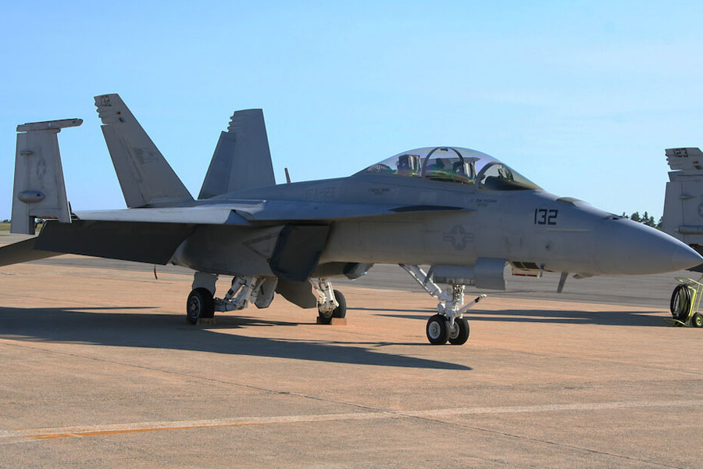

Women’s History
Month 2023
Lieutenant Martinez
NAS Lemoore Female Aviators
Notes:
NAS Lemoore Female Aviators
Lieutenant Martinez
First and last name: Kathryn Martinez
Callsign: Milt
Rank: LT
Aircraft: F/A-18F
Total Flight Hours: 1200
Squadron: VFA-122
Hometown city and state: Springfield, VA
High school: Thomas Jefferson HSST
College: University of Notre Dame
Major: Science Business
Favorite NFL team: Denver Broncos
Hobbies: Soccer, Basketball, Running, playing with my dog and watching UND sports.
The coolest part about being in the Navy:
I grew up in a Navy family and saw the friendships my parents fostered throughout my dad's years in service. Being able to do the same as an adult has made my time in the Navy worth it. The flying is amazing, and the people are even better.
Recently deployed: NOV19-JUN20 with CVW-1 on U.S.S. TRUMAN (CVN-75)
Lieutenant Rudolph
Lieutenant Ashe
Lieutenant Moreno

Slide 8
Women’s History
Month 2023
Lieutenant Rudolph
NAS Lemoore Female Aviators
Notes:
NAS Lemoore Female Aviators
Lieutenant Rudolph
First and last name: Taylor Rudolph
Callsign: Doc
Rank: LT
Aircraft: F/A-18F
Total Flight Hours: 50
Squadron: VFA-122
Hometown city and state: Memphis, TN
High school: St. Benedict at Auburndale
College: The University of Alabama/Med School: VCOM-Carolinas
Major: Biology
Favorite NFL team: Tennessee Titans
Hobbies: Hiking as many National Parks as I can, traveling the country with my husband, and watching Alabama football
The coolest part about being in the Navy:
As a flight surgeon, I have had the opportunity to receive unique medical training in preparation for various austere environments. Flying in an F-18 and integrating into an aviation squadron is such an amazing experience that I would never have as a civilian. Our aviators are some of the hardest working and most selfless people that I have met, it has been such an honor to get to know them and be a part of their careers. The people that I have met, including my husband, have been the best aspect of my time in the Navy and I will cherish those friendships the rest of my life.

Slide 9
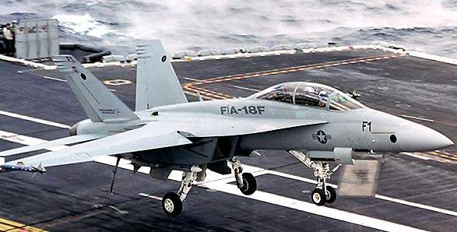
Women’s History
Month 2023
Lieutenant Ash
NAS Lemoore Female Aviators
Notes:
NAS Lemoore Female Aviators
Lieutenant Ash
First and last name: Arielle Ash
Callsign: WHAM
Rank: LT
Aircraft: F/A-18E/F
Total Flight Hours: 910
Squadron: VFA-122
Hometown city and state: Abilene, Texas
High school: Wylie High School
College: Texas Tech University
Major: Public Relations
Favorite NFL team: Texas Rangers
Hobbies: Hiking, camping, snow skiing
The coolest part about being in the Navy:
Flying an F/A-18 is definitely the coolest part about being in the Navy, and getting to fly with some of my closest friends is awesome.

Slide 10
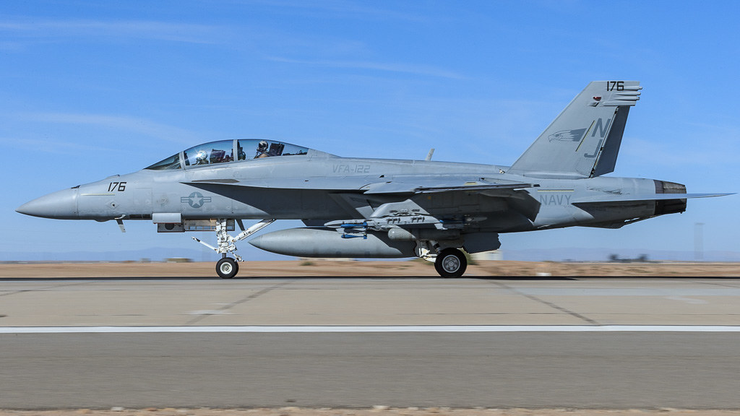
Women’s History
Month 2023
Lieutenant Moreno
NAS Lemoore Female Aviators
Notes:
NAS Lemoore Female Aviators
Lieutenant Moreno
First and last name: Saree Moreno
Rank: LT
Aircraft: F/A-18F
Total Flight Hours: 1200
Squadron: VFA-122
Hometown city and state: Tampa, FL
High school: Academy of the Holy Names, Tampa, FL
College: United States Naval Academy
Major: General Engineering
Favorite NFL team: Tampa Bay Bucaneers
Hobbies: Reading, soccer, weight lifting
The coolest part about being in the Navy:
The actual flying we do is by far the coolest part of being in the Navy. We as aviators forget how unique our job actually is, and being up in the sky has always reminded me how incredible it is.
Recently deployed: APR19-JAN20 with CVW-7 on U.S.S. ABRAHAM LINCOLN (CVN-72)

Slide 11
Women’s History
Month 2023
Thank you to our
Local Women Leaders!
Notes:
Staff requests that your Board adopt a Resolution recognizing March 2023 as Women’s History Month in Kings County. The Resolution has been reviewed as to from by County Counsel.

