Slide 1
Parks & Grounds
Waiving of park entrance fees

Slide 2
COVID-19 Pandemic

Slide 3
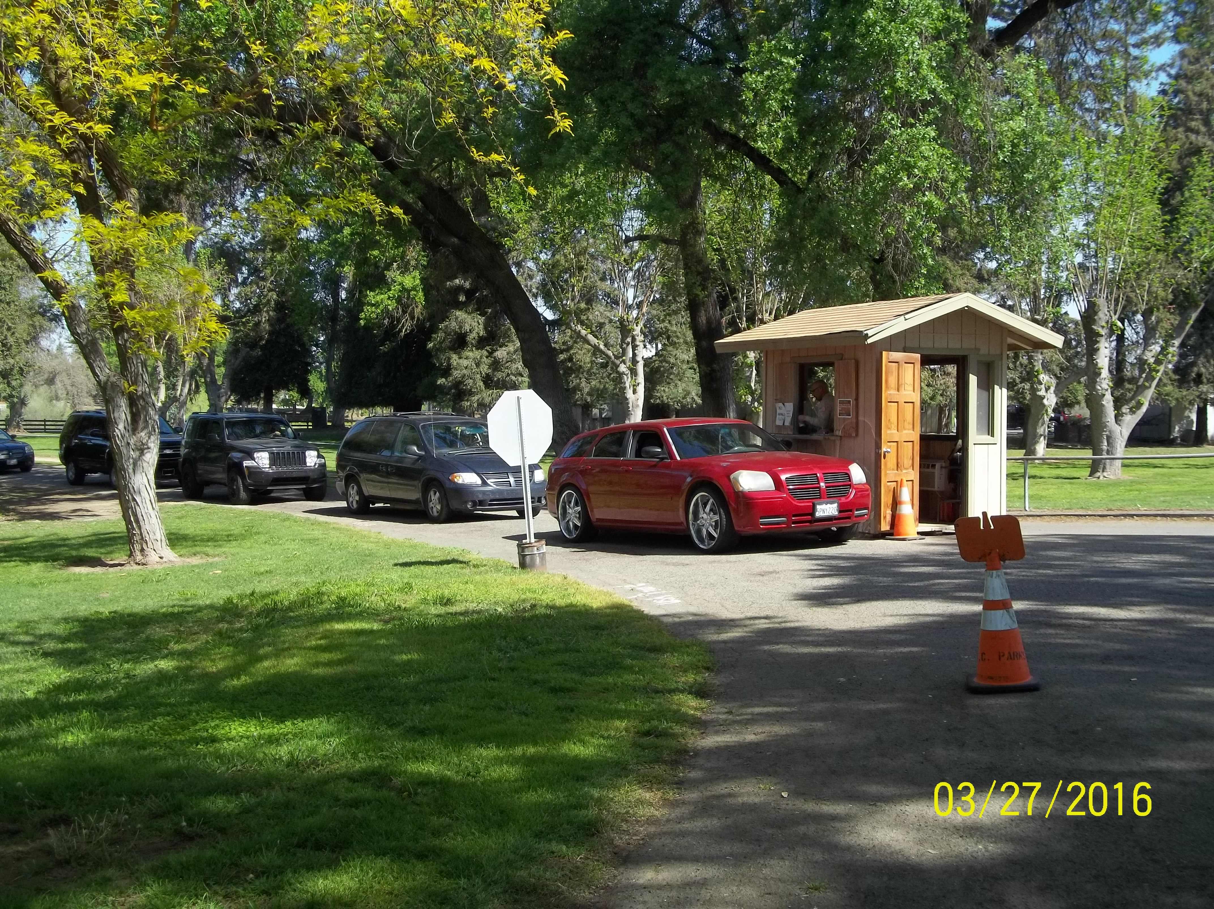
Weekend Schedule
1 FTE at each park
1 PTE at each park
Up to 6 AWF members
Concerns
PTE positions often go unfilled
Over the last 15 years, Parks FTEs have dropped from 12 to 9
AWF help has decreased by 50%
AWF members are left unsupervised due to shortage in staffing
1 FTE salary costs ~$60K

Slide 4
2022 Master Fee Schedule
Total: $22,000
No change

Slide 5
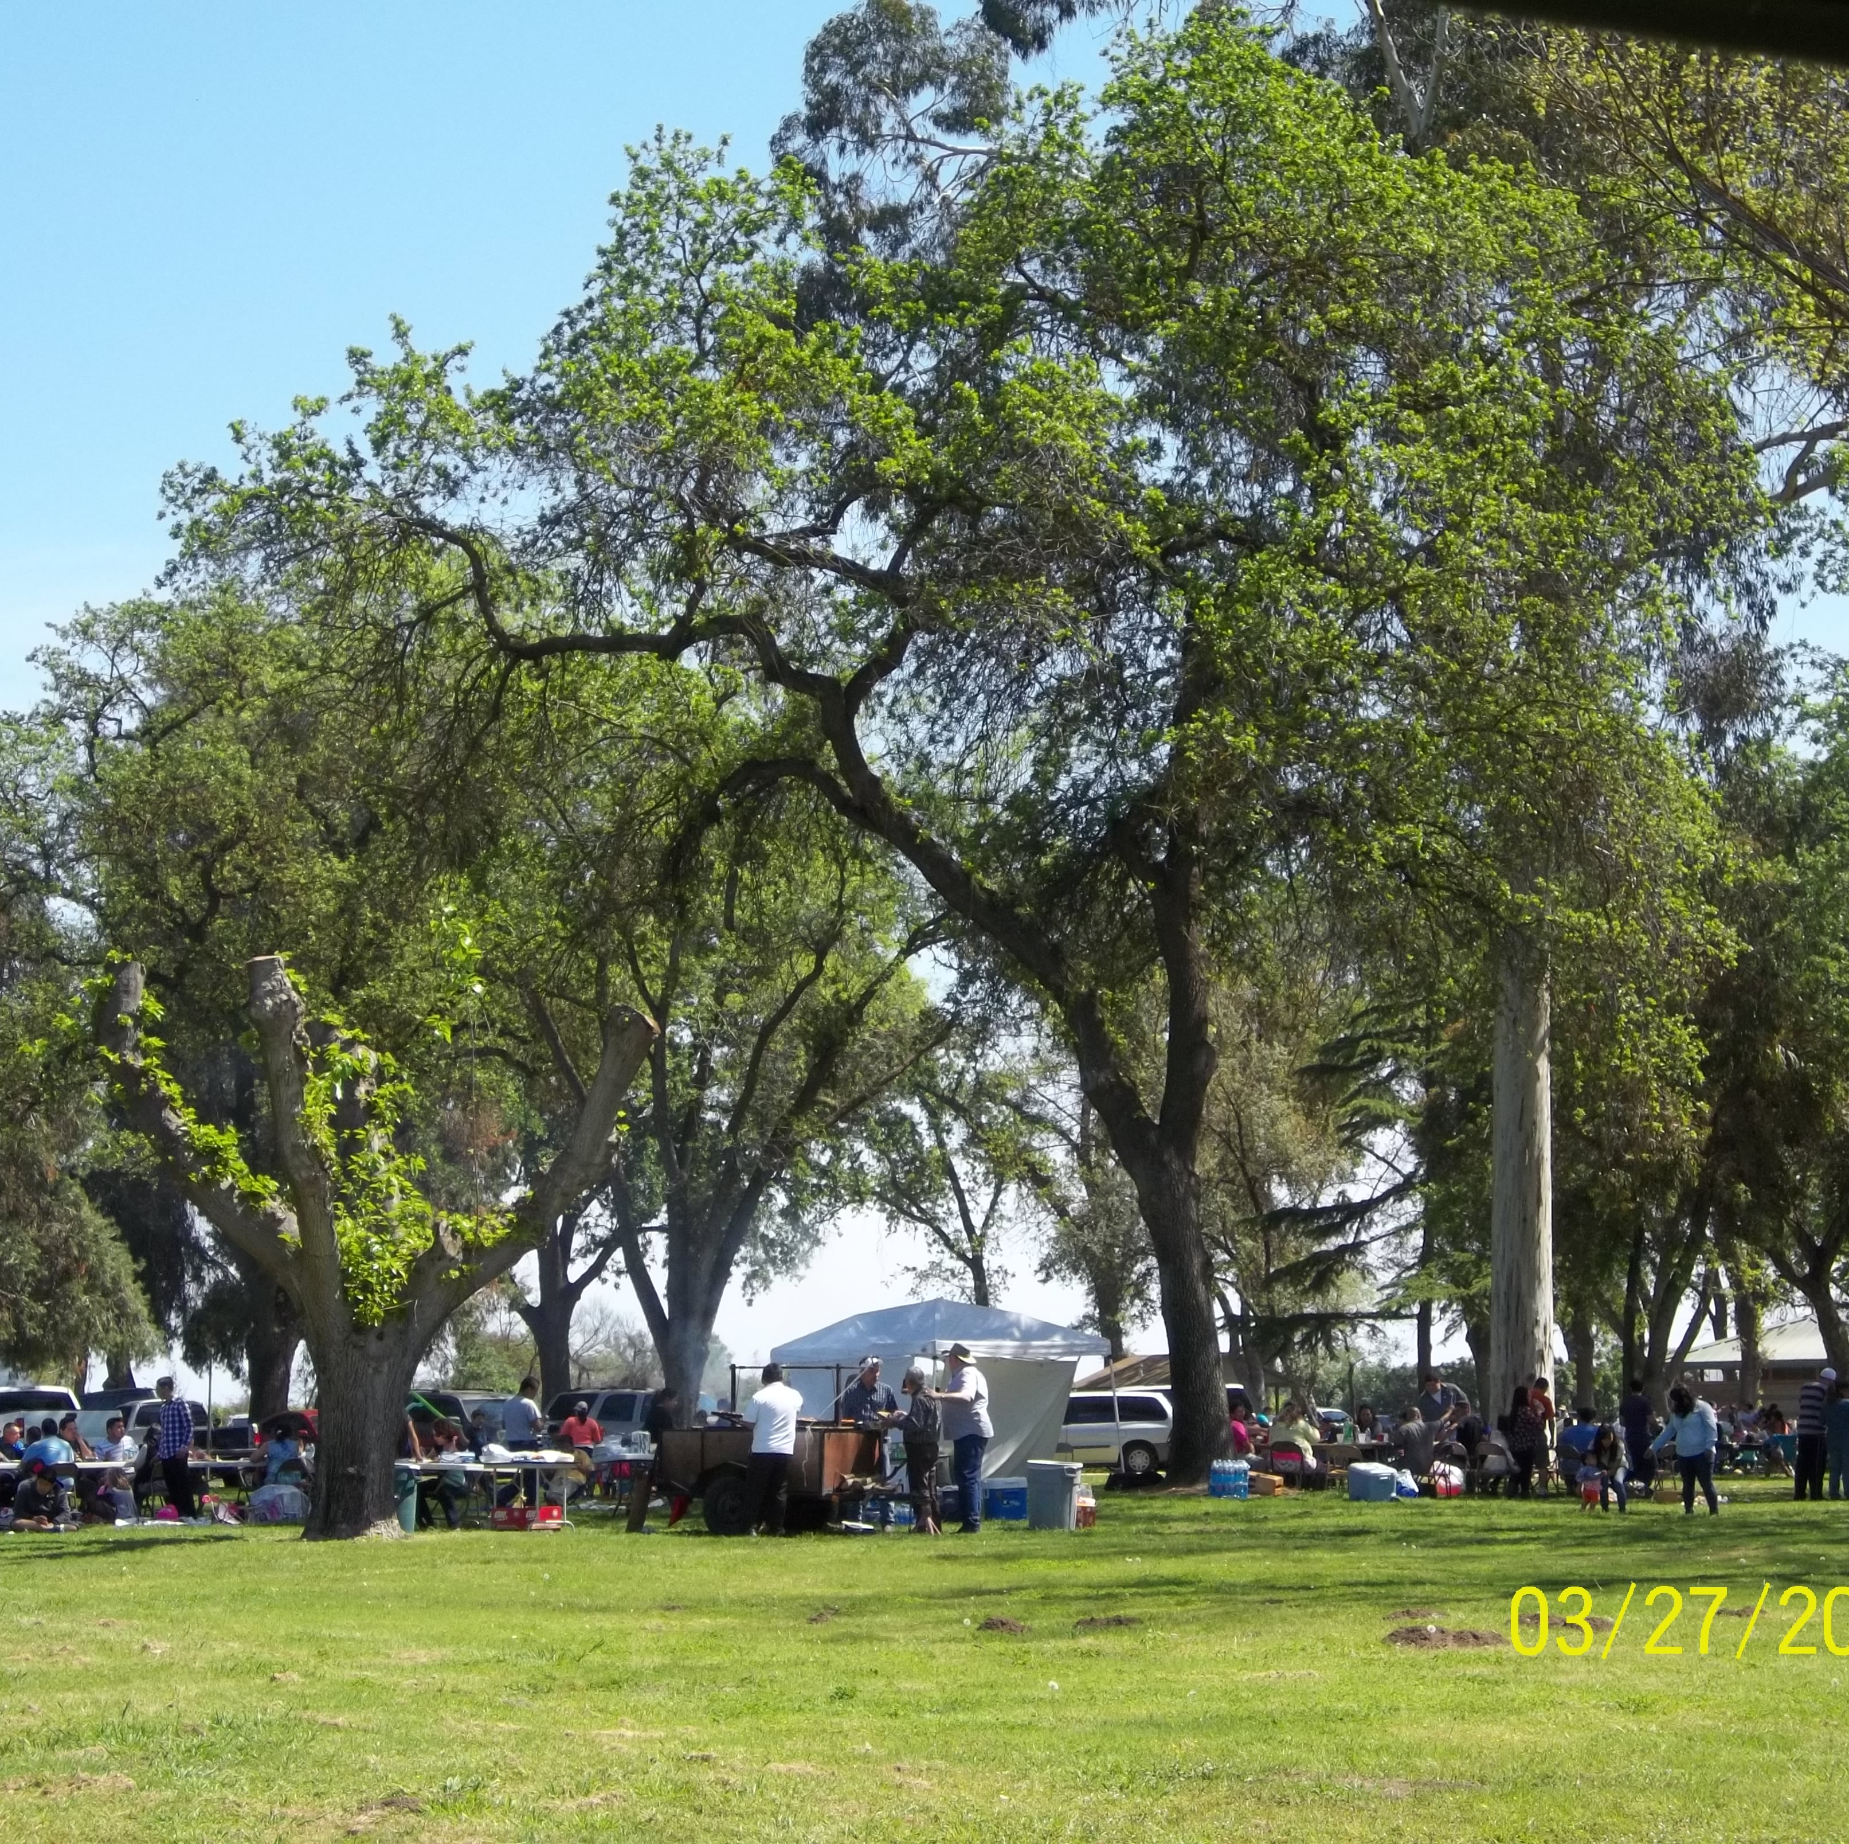
Benefits
Increased opportunity for maintenance and labor
Better use of county resources
Promotion of county relationships
Extending the ability for all individuals to recreate safely

